Slide 2
Outline
Slide#
Section 1 Executive Summary
3
Section 2 The Nigeria Economy
7
Section 3 The Lagos State Perspective
12

Slide 3
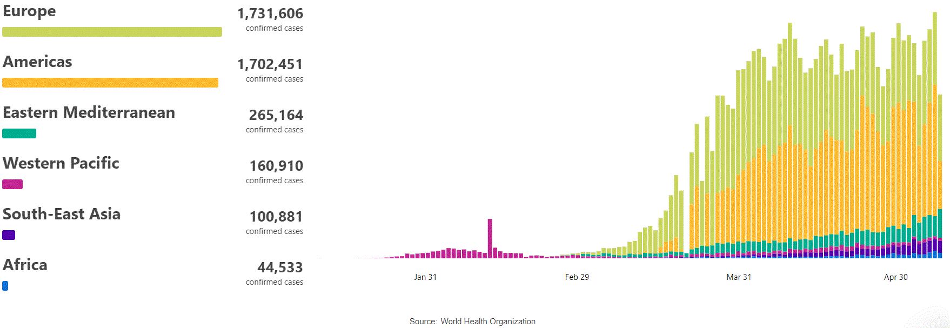
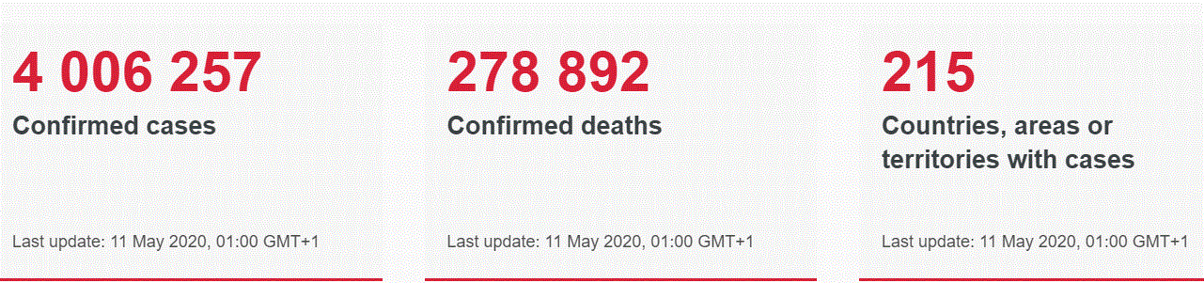
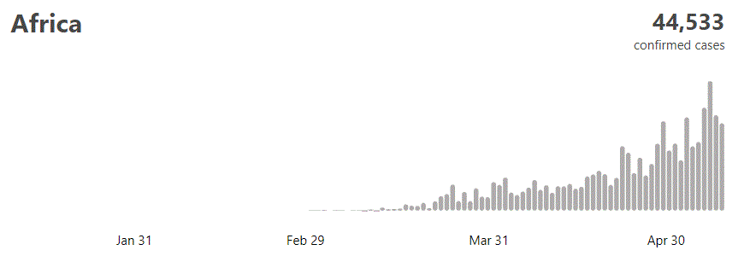
EXECUTIVE SUMMARY – COVID-19 PANDEMIC
The new coronavirus, which first emerged in the Chinese city of Wuhan last December, has infected more than 4,006,257 people in at least 215 countries and territories globally, according to the World Health Organization, with about 278,892 deaths recorded.
As at May 11th, 2020, number of Confirmed cases in Nigeria was 4,399 with 143 deaths and 152 recovered
The WHO acknowledged Nigeria’s approach to handling the incidence, obviously drawing from the lessons of dealing with Ebola virus in 2014.
  Aggressive Contact Tracing
  Patients in three types of isolation centres and isolation centres expansion ongoing
  Resource mobilization – public and private sectors
The race is still on to find an effective vaccine to tame the virus, while some combination therapy is being tested in clinical trials.

Slide 4
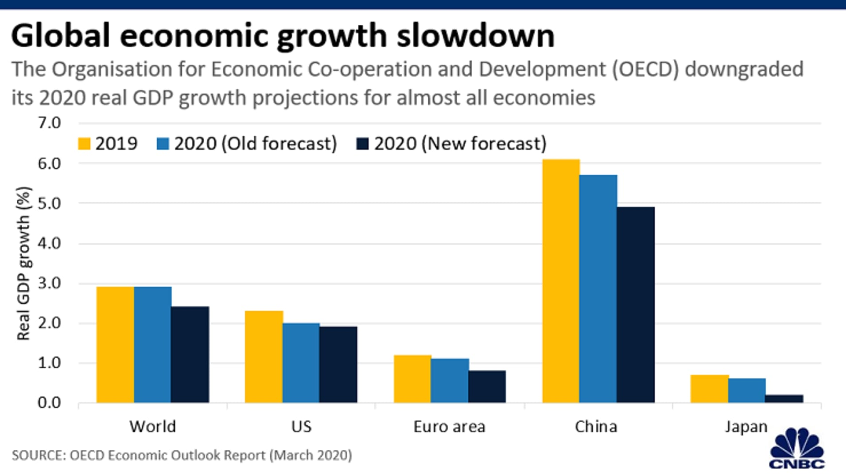
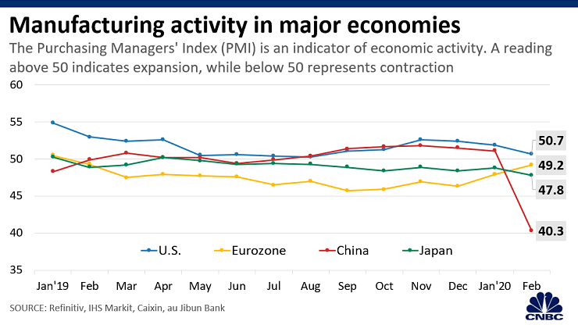
EXECUTIVE SUMMARY – COVID-19 PANDEMIC
Points to Note
The manufacturing sector in China, Europe & America has been hit hard by the virus outbreak
These regions account for about 85% of the world’s manufacturing output with China accounting for about 30% of total output
Factories in China are taking longer than expected to resume operations, and with the rate of spread of the coronavirus, global manufacturing activity could remain subdued for a much longer period

Slide 5
MAJOR GLOBAL CHALLENGES
According to Jodie Keane, a Research Fellow at the Overseas Development Institute (ODI), there are four major challenges evolving as the Covid-19 pandemic spreads:
  Demand & Supply Side shocks
  Global recession
  Changes to Lead firm strategies
  Increased economic vulnerability
1
Collapse of demand is a problem for resource dependent countries and firms in such countries
Collapse of supply of essentials
2
The global economy is already in recession, with lockdown in most countries involving estimated 2.5 billion people or 30% of world population
3
The global supply chains are shortening, as retailers close their stores and distributors and manufacturers are forced to shut down, furloughing their employees
4
Reversal of growth trajectories for emerging and frontier economies as well as some of the Least Developed Countries. The SDGs may become a mirage

Slide 6
GLOBAL ECONOMIC IMPLICATIONS
As at March 2020, the perspective of McKinsey was three scenarios
1
2
3
Quick Recovery
Adverse effects to end Q1 2020
Global and regional economies recover quickly and still achieve the growth rates projected earlier in the year
Global Slowdown
Adverse effects linger till end of Q3, 2020
Most regions will experience between 20% and 22% GDP slow down, except Sub-Saharan Africa that will dampen by only 9.5%
Pandemic driven economic recession
Global and regional economies will be unable to recover in 2020.
China will suffer least, while the EU will be most impacted.
Irrespective of the outcome it has become evident that the global economic landscape and the way in which businesses are managed globally would never remain the same again

Slide 7
Section 2 The Nigeria Economy

Slide 8
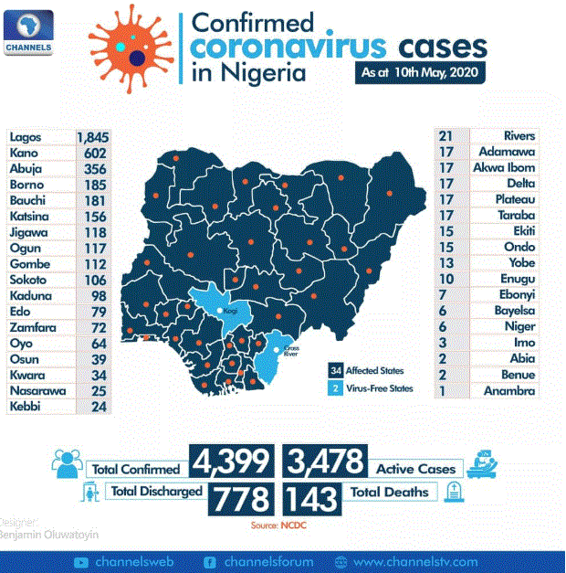
CORONA VIRUS PANDEMIC UPDATE

Slide 9
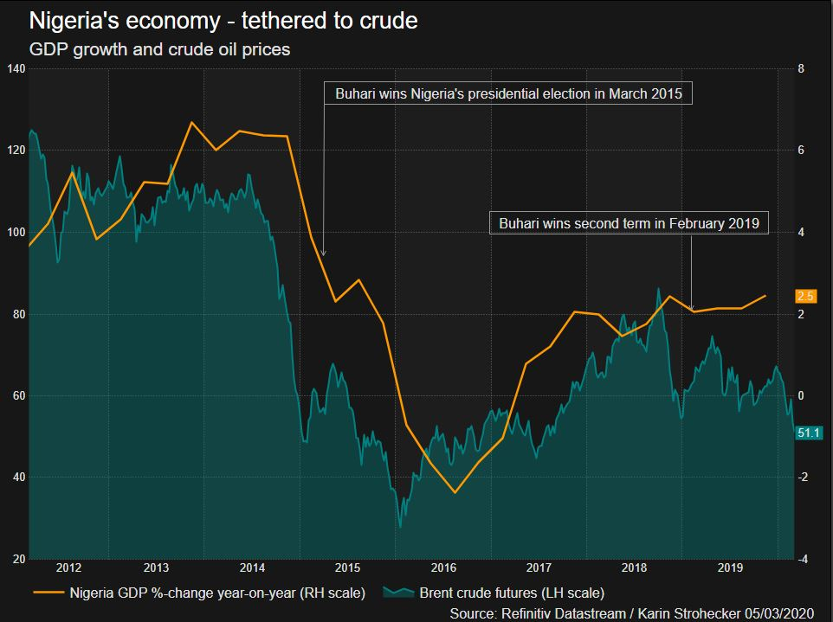
THE REVENUE CHALLENGE
China accounts for around 25% of Nigeria’s imports, greasing much of its supply chain in household commodities and is funding and building much-needed infrastructure
China’s economic health is also crucial for oil prices, which make up more than half of government revenues, and have tumbled more than 20% since January.
Oil is Nigeria’s biggest export and the government relies on this resource for its dollar earnings to fund its budget
At close to $30 per barrel, oil prices are below the $57 per barrel budget benchmark. OPEC backing the biggest cut to oil supplies since the 2008 crisis, means Nigeria will have to reduce output, and hence reduced revenues, hence the need for a budget re-order
Combined with disrupted supply chains and the threat of coronavirus spreading within Nigeria, this threatens to torpedo growth in the economy and boost borrowing costs just as the country plans to return to the Eurobond market.
The CBN’s current intervention in the adjustment of the currency is a first step as it tries to cater for the effects of the declining oil prices and foreign reserves on the nation’s economy
Albeit, the Nigerian economy remains largely volatile, and is on the verge of a recession, if this pandemic and its adverse effects on the economy continues

Slide 10
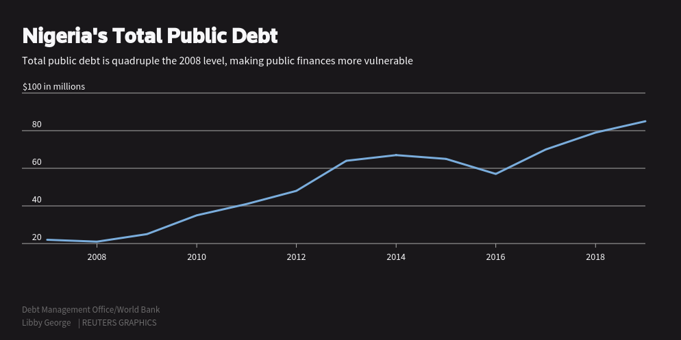
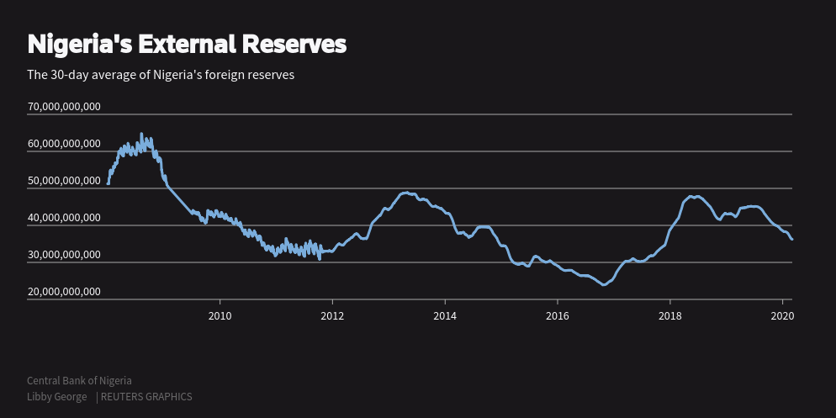
WOULD NIGERIA REVENUE GET BETTER?
Points to Note
Nigeria is more vulnerable than ever before being that its shaky exit from recession in 2016 and poor growth of about 2% annually, could make this setback harder to weather through.
Moody’s, which downgraded the country’s outlook in December, has warned that its debt, which stands at N26trillion, and plans by the Federal Government to borrow another $3billion, make it more susceptible to external shocks.
The current ease of lockdown imposed by the Government is already taking its toll with reduction in disposable income and increases in domestic violence and civil unrests

Slide 11

DOLLAR SHORTAGE– COULD THERE BE A DEVALUATION OF NAIRA?
While only just beginning, the growing dollar shortage is already assuming the status of a similar occurrence in 2016, with Government imposing currency controls in a bid to stem the flow of foreign exchange out of the country given dwindling foreign reserves.
But these measures are likely to have damaging effects as restricted access to dollars would leave businesses unable to import raw materials and locals unable to meet dollar-denominated expenses, including medical expenses and tuition at foreign schools.
Many critics have long claimed the naira was effectively being overvalued by the central bank’s currency controls and at various points in recent years, there have been calls for the naira to be allowed to float to find its true level.
While the CBN insists that a devaluation is not being considered, recent history has shown that this might be a probable eventuality

Slide 12
Section 3 The Lagos State Perspective

Slide 13
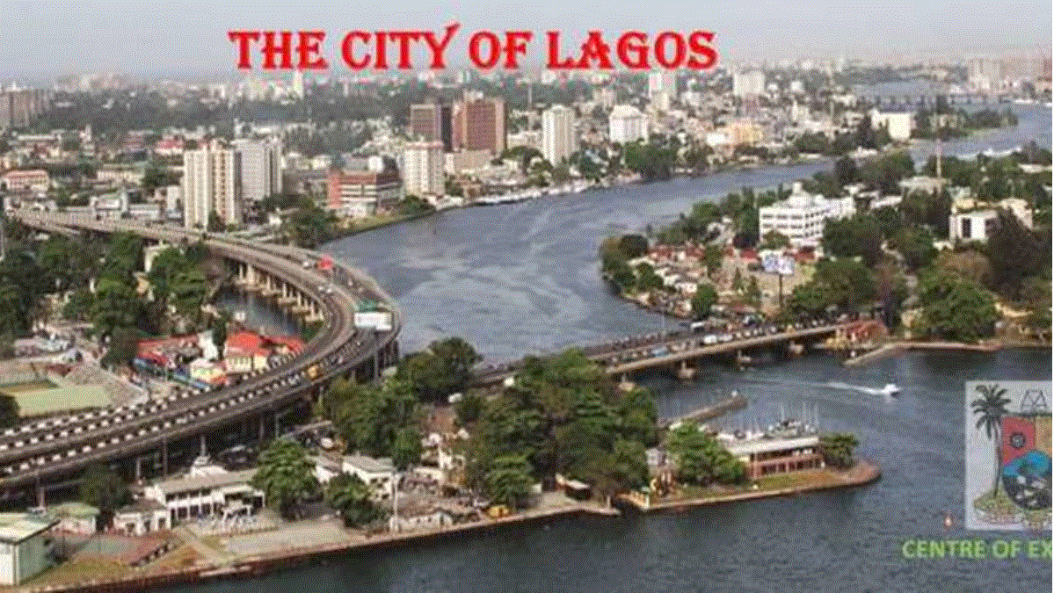
LAGOS STATE AND CORONA VIRUS- SYNOPSIS
With over N690b IGR in 2019
Over N1trillion projected revenue in 2020
22million population
5th biggest Economy in Africa
Nigeria’s Corona Virus Epicenter
Over 1,933 confirmed cases in Lagos State, 502 recovered cases and 33 deaths
Direct Impact
Drop in IGR
Drop in Federal Allocation
Increased Unemployment
Potential decline if FPIs/FDIs
Lagos State will be forced to increase its debt
Increased pressure on income and purchasing power of Lagosians
Direct Response/Palliatives
FY2020 Budget re-ordering
Capital Expenditure re-priotise
Extension of Tax Filing Date
Principal & Interest moratorium for LSEFT loans
Possible extended tax payment plan

Slide 14

THE FUTURE OF BUSINESS MODEL
The Global Economic implication of COVID-19 pandemic span across recession, negative GDP growth, Inflation and Unemployment. It is estimated that 1/5th of global businesses might not survive this pandemic.
For Entrepreneurs and captains of industries, this is a big test of survival as their businesses going concern have directly impact on the Economy. There is therefore no error in saying that an Economy is as good as its level of industrialization
Key Steps to be considered
Develop/review existing Business Continuity plan to ensure going concern
Develop fiscal risk policy
Reduce meetings and travels
Ensure a robust health plan
Rightsizing across your resource spectrum
Get rid of foreign currency non-earning assets
Pursue operational and cost efficiency

Slide 15
THANK YOU

